Slide 1
TELECOM CHURN CASE STUDY
CASE STUDY PARTNER: VIREN GANDHI MAYANK JAIN NAMRATA AHIRRAO

Slide 2
PROBLEM STATEMENT
◆ In the telecom industry, customers are able to choose from multiple service Providers and actively switch from one operator to another.
◆ In this highly competitive market, the telecommunications industry experiences an average of 15-25%annual churn rate.
◆ Given the fact that it costs5-10 times more to acquire a new customer than to retain an existing one, customer retention has now become even more important than customer acquisition.
◆ For many incumbent operators, retaining high profitable customers is the number one business goal.
◆ To reduce customer churn, telecom companies need to predict which customers are at high risk of churn.
◆ In this project, you will analyze customer-level data of a leading telecom firm, build predictive models to identify customers at high risk of churn and identify the main indicators of churn.

Slide 3
BUSINESS OBJECTIVES:
◆ The business objective is to predict the churn in the last (i.e.the ninth)month using the data (features) from the first three months.To do this task well, understanding the typical customer behavior during churn will be helpful.
◆ Highligting the main variables/factors influencing the Customer churn.
Use various ML algorithms to build prediction models, evaluate the accuracy and performance of the models.
◆ Finding out the best model for our business case and providing executive summary.
◆

Slide 4
Process and Methodologies followed to analysis:
Data cleaning and data manipulation.
Check and handle duplicate data.
Check and handle NA values and missing values.
3.Drop columns, if it contains large amount of missing values and not useful for
the analysis.
Imputation of the values, if necessary.
Check and handle outliers in data.
EDA
1.Univariate data analysis: value count, distribution of variable etc.
2.Bivariate data analysis: correlation coefficients and pattern between the
variables etc.
3. Using different plot like count/bar/pie/hitmap
Data Understanding and EDA
Handling the Class imbalance
Model Building Using Logistic Regression and DecisionTree
Feature Selection using RFECV
Business Recommendation

Slide 5
Methodologies followed to analysis:
◆ Feature Scaling & Dummy Variables and encoding of the data.
◆ Splitting the data into Test and Train dataset
◆ Classification technique: logistic regression used for the model making and prediction.
◆ Evaluation the model by using different metrics like Specificity and sensitivity or precision and Recall
◆ Validation of the model.
◆ Model presentation.
◆ Conclusions and recommendations.

Slide 6
Methodologies followed to analysis:
Data Sourcing, clearing and preparation:
Read the data from sources
Convert the data in clean format so it is suitable for analysis
Remove duplicate data if any
Outlier treatment
EDA
Feature standardization
Model Building:
Feature selection using REF
Determine the optimal model using logistic regression
Calculation of various metrics like accuracy,
sensitivity, specificity, precision and recall
Evaluation of model
Feature scaling and splitting of data:
Feature scaling of numeric data
Splitting data in to train and test at ratio of 80:20
Results
Creating column avg_rech_amt_6_7 by summing up total recharge amount of month 6 and 7.Then taking the average of sum.
Evaluate final prediction on the test set using threshold limit

Slide 7
Read and understand the data:
There is total 99999 rows and 226 columns.
Out of 226 there are 179 float, 35 integer and 12 are objective variables.
Out of total business only high value customers gives around 80%.
There are outliers present mostly in ‘incoming calls usage ‘ and ‘outgoing calls usage.

Slide 8
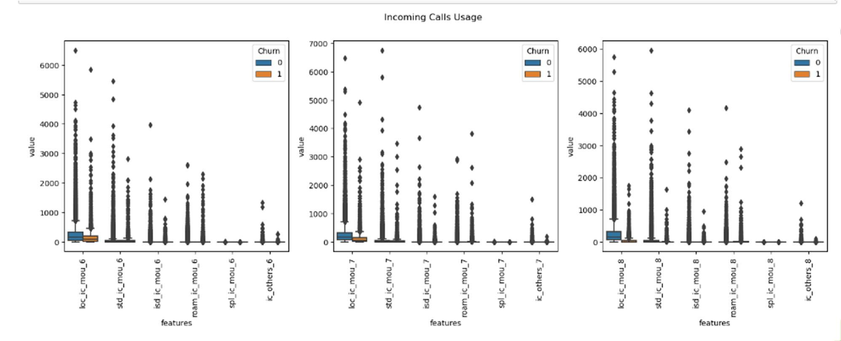

Exploratory Data Analysis-check for outliers-Incoming call

Slide 9
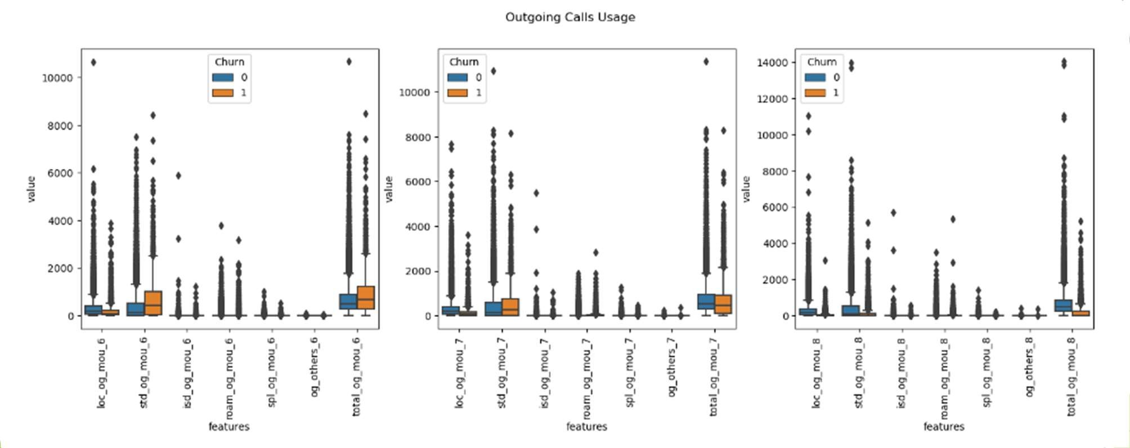
Exploratory Data Analysis-check for outliers-Outgoing call

Slide 10
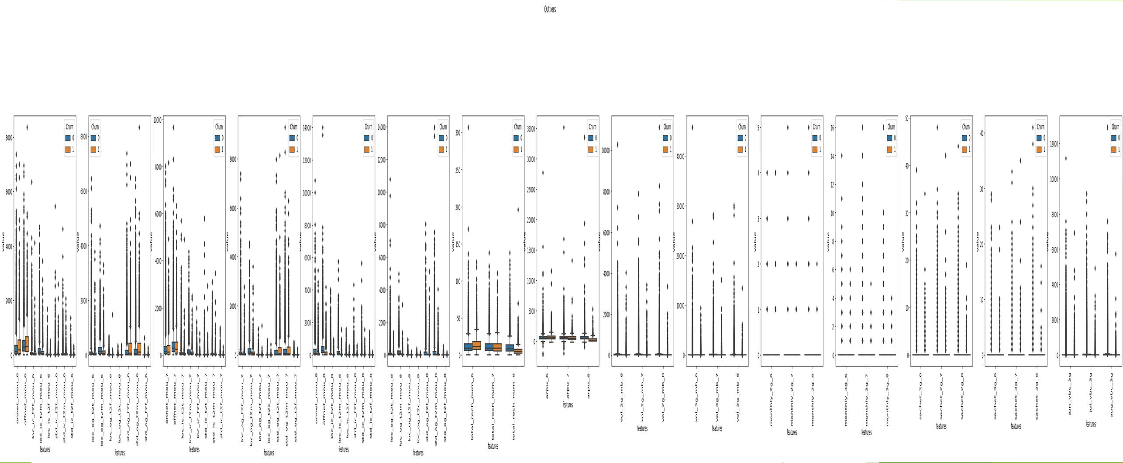
Exploratory Data Analysis-check for outliers

Slide 11
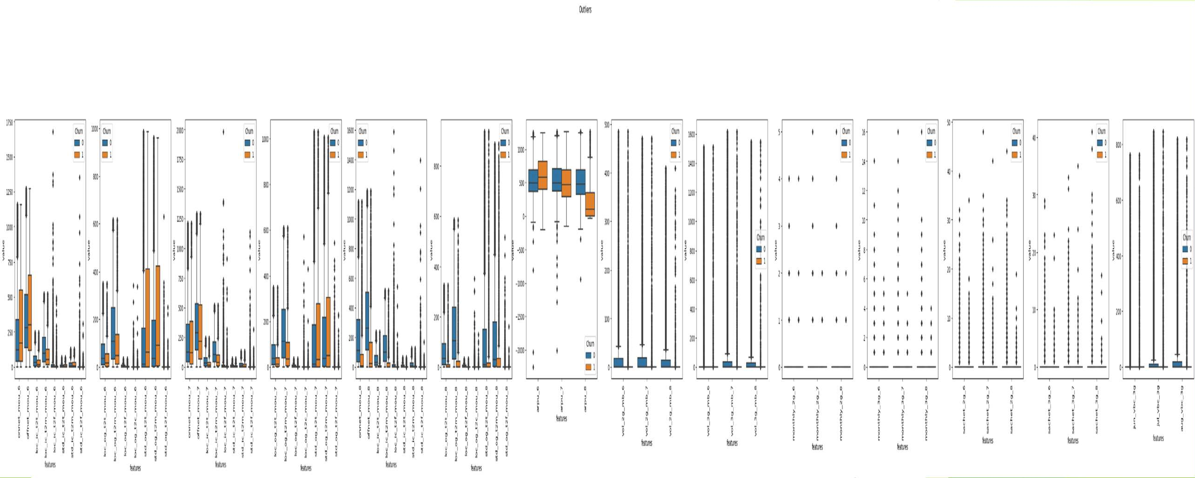
Exploratory Data Analysis-after working on outliers

Slide 12
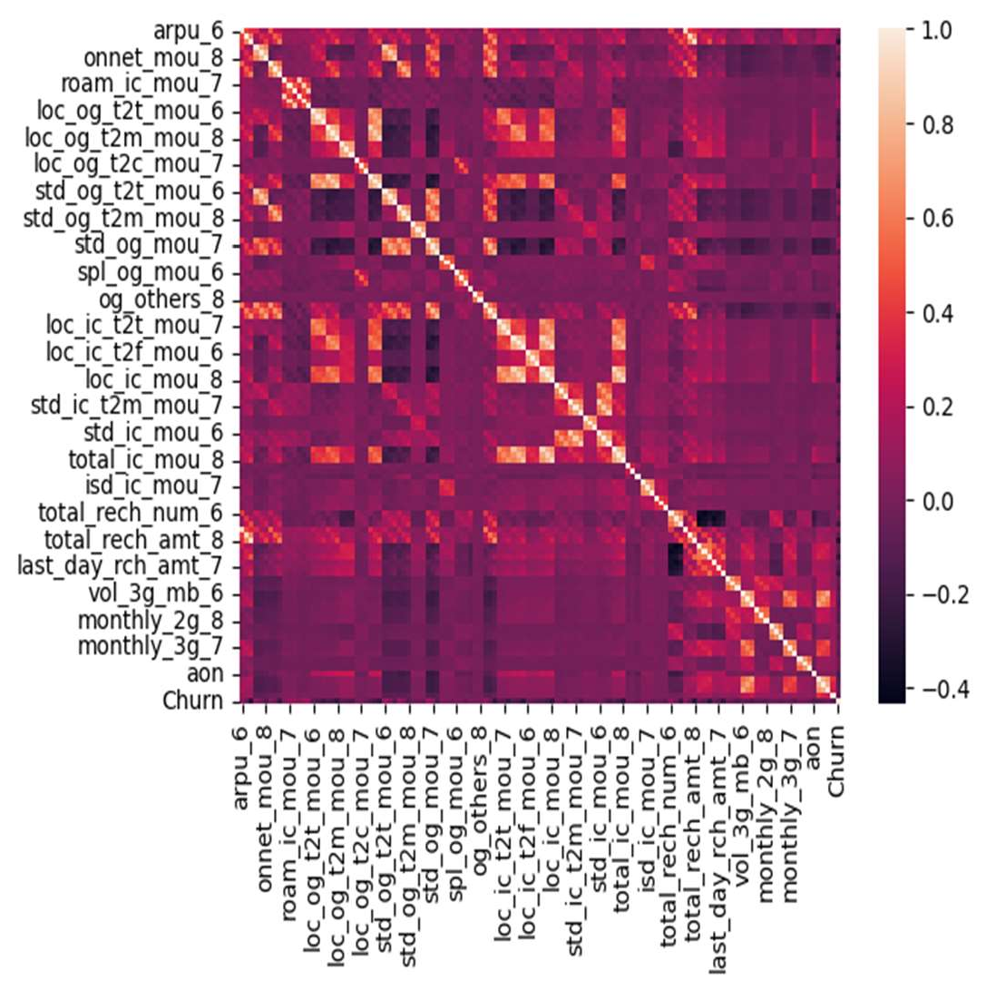
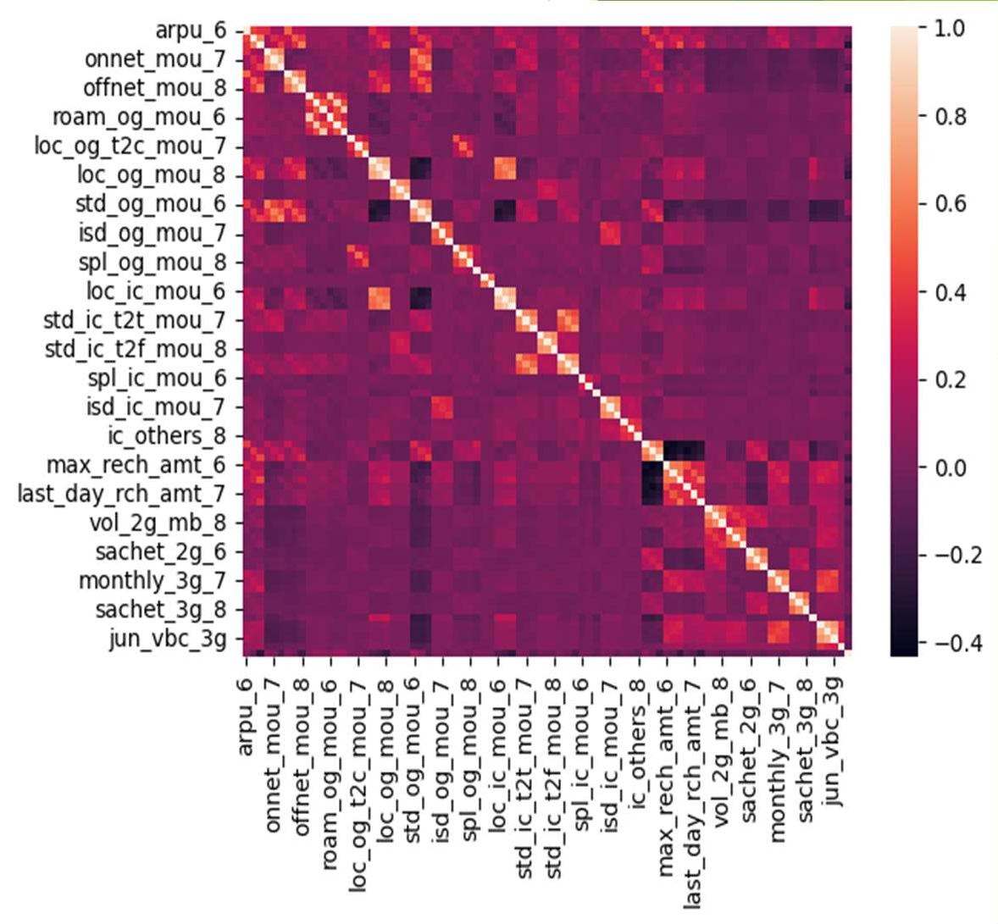
Handling Multicollinearity using Correlation-
Before and after treatment

Slide 13
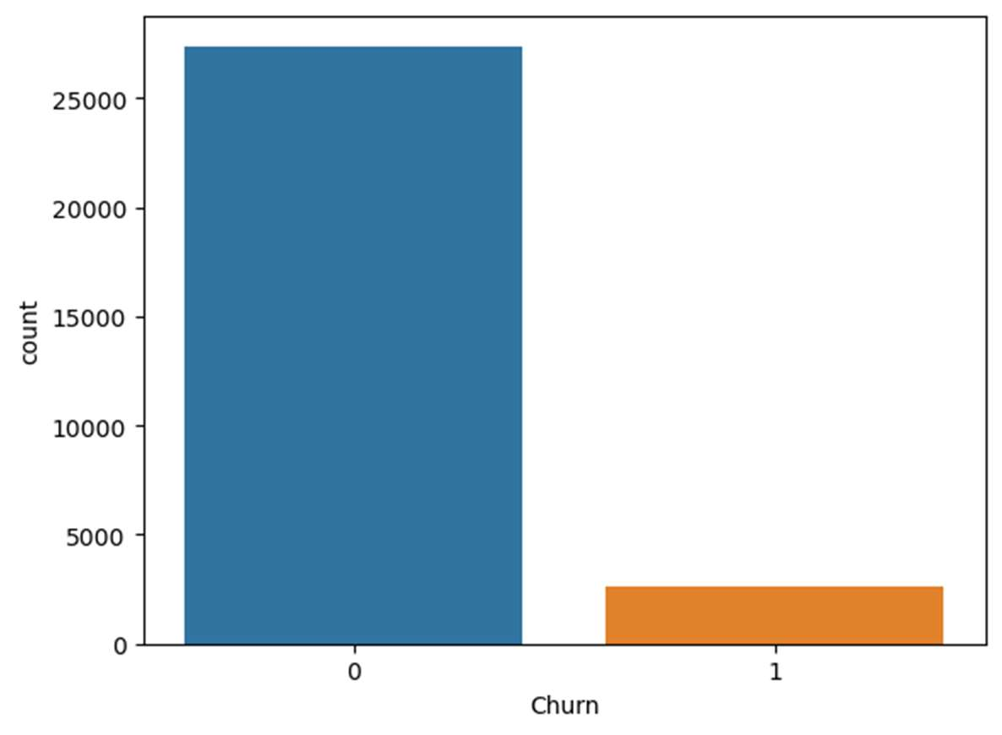
EDA Box plot for Class imbalance.
As we can see there is a clear case of class imbalance
So we need to handle the class imbalance.

Slide 14

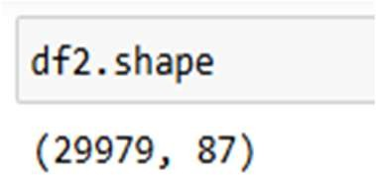






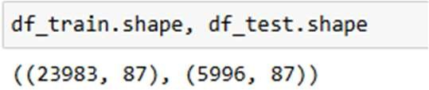
TRAIN AND TEST DATA:
◆ Data set before split
Data Set after spliting
5996, 20%
Train Data Test Data
23983, 80%
◆ Data Set after split in to 80:20

Slide 15
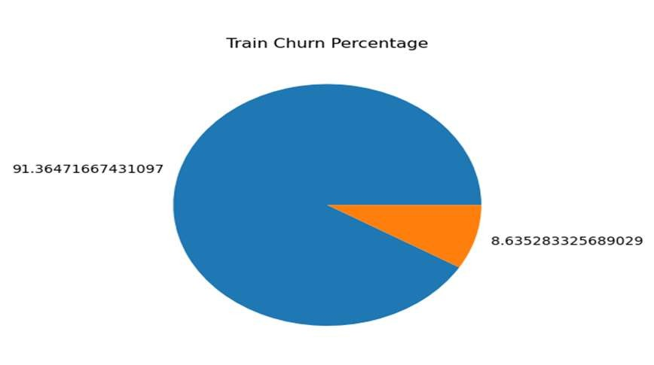
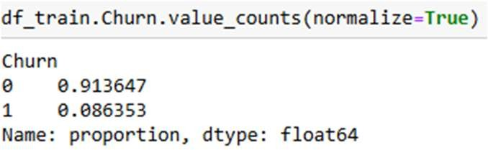

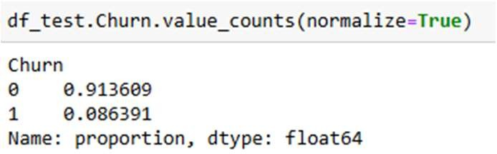
TRAIN AND TEST CHURN VALUE COUNTS:
◆ Train Churn Value Count
◆ Test Churn Value Count

Slide 16
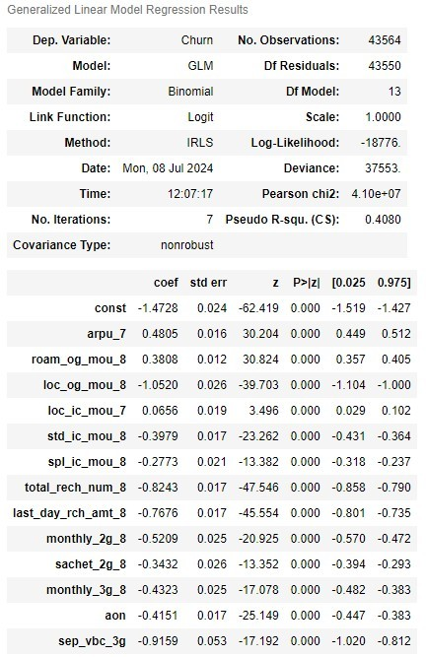
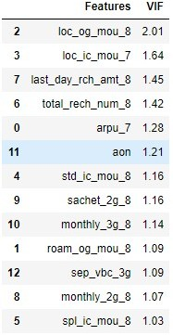
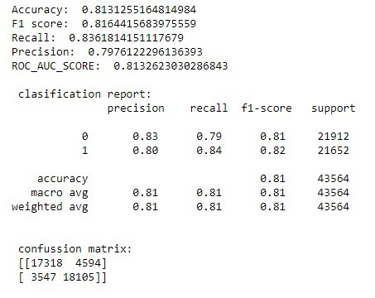
Model Building Using Logistic Regression:
Fourth training model gives us good p value and scores.

Slide 17
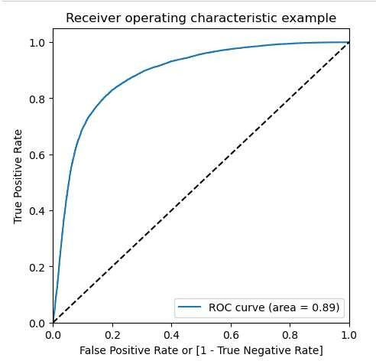
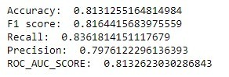
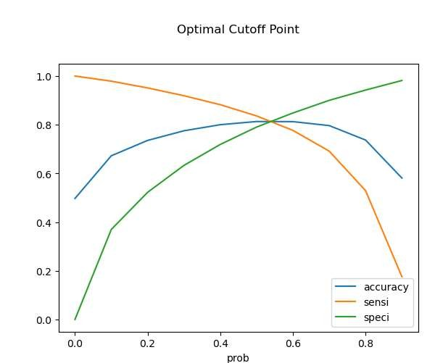
MODEL EVALUATION-ROC,SENSITIVITY AND SPECIFICITY
Confusion Matrix
17318
4594
3547
18105

Slide 18
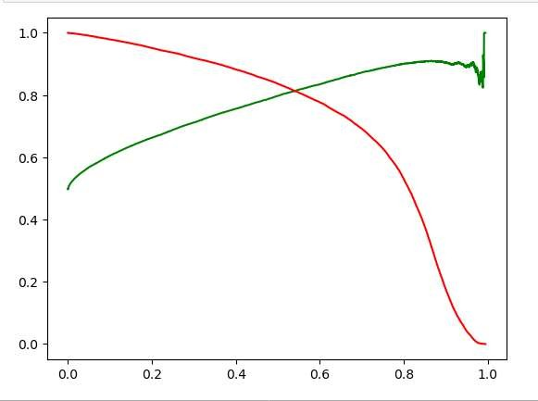
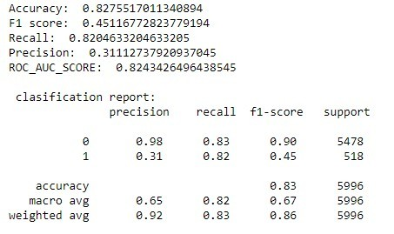
PRECISION AND RECALL TRADE OFF
Confusion Matrix
4537
941
93
425

Slide 19
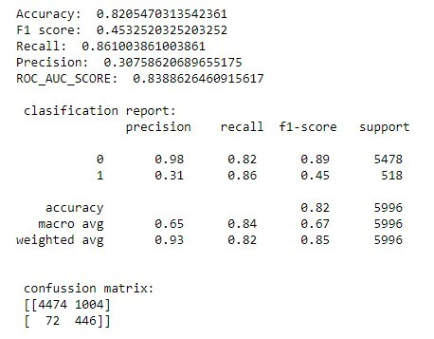
DECISSION TREE
On Train Data
On Test Data

Slide 20
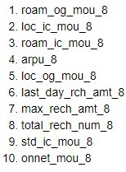
most important features for our final model are all from action phase.

Slide 21
CONCULSION:
◆ The company after identifying customers in action phase can give offers for increasing local incoming and outgoing minutes of usage.
◆ Customers are more keen towards the local incoming calls over anything so, we can provide more free incoming calls and also we can reduce the outgoing calls charges for better connectivity.
◆ This can provide an advantage over other operators in the market
◆ The roaming charges can be made lesser by giving offers.
◆ More importantly we can provide free incoming calls on roaming.
◆ We can provide attractive offers and packages for the customers.

Slide 22


THANK YOU

